Slide 1

Object Orientated Software Engineering
6.2 The Observer Pattern
By Stephen Lindsay

Slide 2
Outline
The “Gang of Four” and their 23 design patterns
The Observer Pattern
Upgrading Observer or how real-life concerns meet design patterns

Slide 3
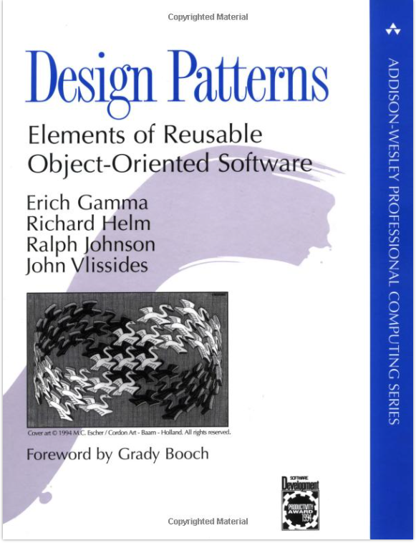

Slide 4
The Gang of Four
Design Patterns – Elements of Reusable Object-Oriented Software was published in 1993 and remains relevant to this day
The book sets out 23 design patterns broken down into Creational, Structural and Behavioural categories
The ideas have stood the test of time and are used in many major software development companies
There are more than 23 design patterns out there and more than the three basic groups as well
Concurrency for example gives rise to a whole new set of design patterns like the Lock pattern

Slide 5
Design Pattern Criticisms
Some people think that design patterns are indicators of deficiencies in programming languages
16 of the 23 design patterns are simplified or not needed at all in Lisp
Some design patterns are considered anti-patterns because they are over-used by programmers
The Singleton pattern is an example of this
Criticisms have some technical and applied merit but think right tool for the job and a job for every tool
If you use a hammer to drive in a screw and complain it takes forever or a screwdriver to hammer in a nail and damage your screwdriver, is it the tool at fault or you?

Slide 6

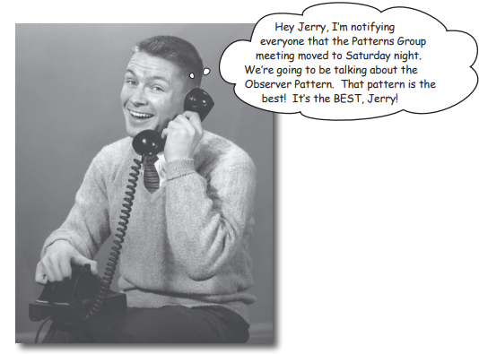
Image taken from Head First Design Patterns, Title Page and C2

Slide 7
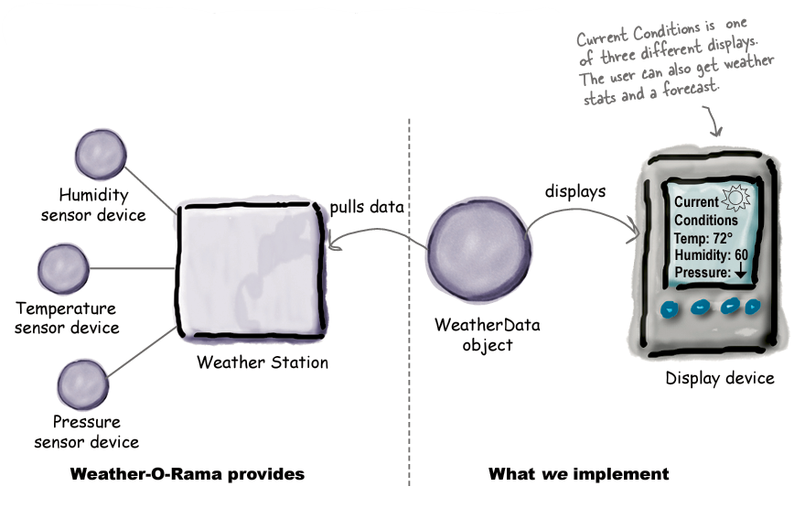
Image taken from Head First Design Patterns, C2

Slide 8
The Weather Station Problem
Imagine your development team is interested in monitoring real time data from a weather station and exposing the data for other developers to use. There are three major elements:
Humidity, Temp and Pressure are grabbed by sensor devices
A WeatherDataObject somehow gets the data
A device that wants to display the data in several different ways
In this example, we are going to abstract away from how data gets to the WeatherDataObject
maybe it’s coming over a network, maybe the weather station is plugged into the computer and communicates over a socket, for now we don’t care

Slide 9
Image taken from Head First Design Patterns, C2

Slide 10
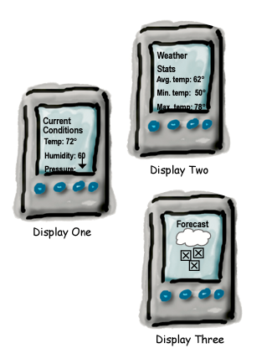
Image taken from Head First Design Patterns, C2

Slide 11
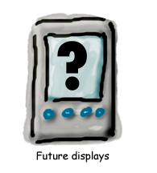
Image taken from Head First Design Patterns, C2

Slide 12
Weather Station – a naive solution
// This code get’s called whenever the
// weather measurements have been updated
public void measurementsChanged(){
// your code here
}
So we need to update measurementsChanged so it updates the three displays – simple!

Slide 13
Weather Station – a naive solution
public void measurementsChanged(){
currentConditionDisplay.update(temp,humidity,pressure);
statisticsDisplay.update(temp,humiodity,pressure);
forecastDisplay.update(temp,humidity,pressure);
}
So what problems can we foresee in this style of implementation?

Slide 14
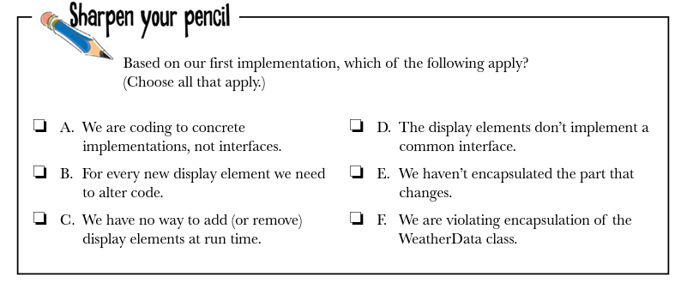
Image taken from Head First Design Patterns, C2

Slide 15
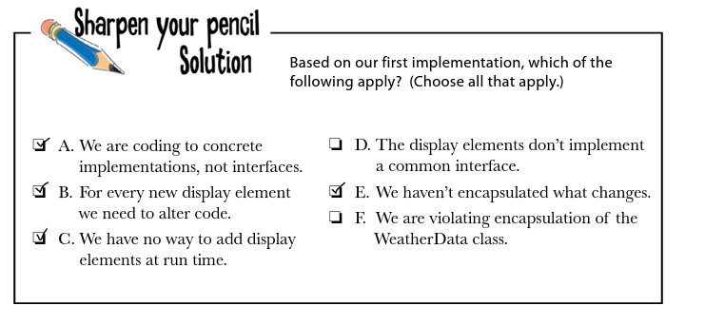
Image taken from Head First Design Patterns, C2

Slide 16
What do those problems mean for us?
Central issue: We can’t add or remove new display elements without changing our code
What happens when a new developer extends our work? They edit out code? That’s not good practice (SOLID – Open/Closed)
The Observer Pattern addresses this issue at it’s heart, when you need to share information with others without knowing who they are, how many of them there are, or what they will do with the information

Slide 17
The Observer Pattern Basics
Think of how a newspaper works:
Newspaper publisher starts to publish news
People interested in the news subscribe to the paper and when a new edition comes out, they get it delivered
You unsubscribe when you are no longer interested and deliveries stop
How does that look in object oriented programing?

Slide 18
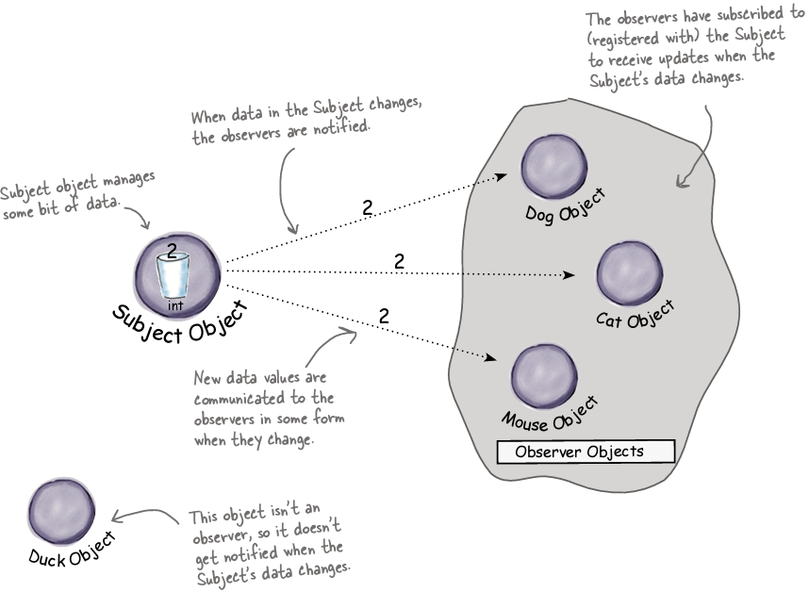
Image taken from Head First Design Patterns, Chapter 2
Notes:
Solution and problem

Slide 19
Observer in Java
At the heart of the observer pattern are two Interfaces, Subject and Observer (Publisher/Subscriber, Watchable/Watcher)
Observer contains:
notify();
Subject contains:
registerObserver(Observer o)
removeObserver(Observer o)
notifyObserver()

Slide 20
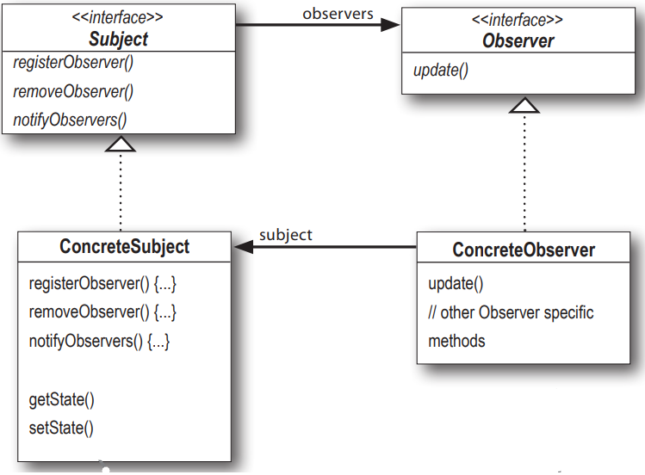
Image taken from Head First Design Patterns, Chapter 2

Slide 21
WeatherData
public class WeatherData implements Subject {
private ArrayList observers;
private float temperature;
private float humidity;
private float pressure;
…

Slide 22
WeatherData
…
public void removeObserver(Observer o) {
int i = observers.indexOf(o);
if (i >= 0) {
observers.remove(i);
…
public void notifyObservers() {
for (Observer observer : observers) {
observer.update(temperature, humidity,
pressure);

Slide 23
WeatherData
// say for the sake of argument we are updating
// via get and set methods
public void updateTemperature(float temperature) {
this.temperature = temperature;
notifyObservers();
}
public void updateHumidity(float humidity) {
this.humidity = humidity;
notifyObservers();
}

Slide 24
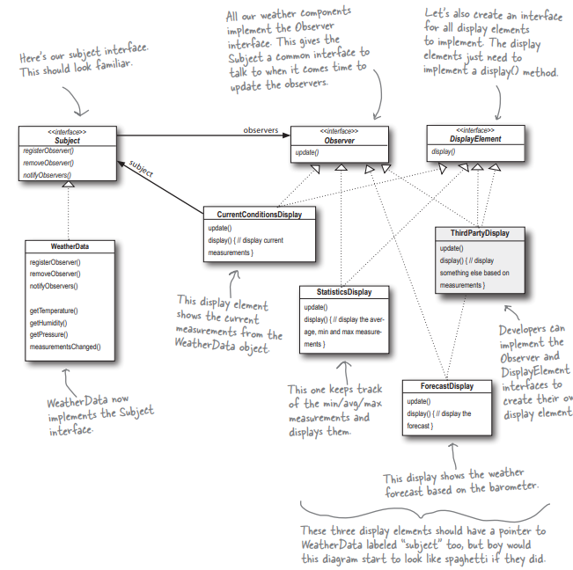
Image taken from
Head First Design
Patterns, Chapter 2. pg 52

Slide 25
Real World Problems
What might we need to consider in practical implementations of this design pattern?
Scale of updates – imagine we are measuring to every 10,000th of a degree – do we need to notify observers for every change?
Frequency of updates – imagine the above and we have a 10,000Hz sensor, we’ll be pushing out 30,000 updates a second
Size of the update – imagine we are sending out serialised objects instead of floats – we’d be sending out a lot of data on our network!

Slide 26
Improving the Pattern
We can start to handle these issues by minimising the transmission of data to only happen:
When our observing classes are interested in getting an update
We move from a push model (every time a change happens we send data) to a pull model (every time a change happens we notify observers and they decide if they want to pull data
When we know we have significant data to send out
We implement a flag to mark when changes in data are significant enough to warrant WeatherWata sending out an update

Slide 27
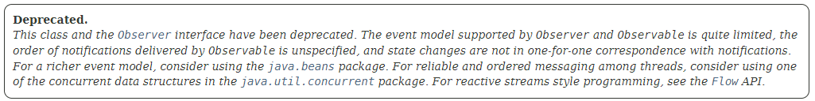
A note on java.util.Observable
If you are following Head First you’ll notice they give the example of the Observer and Observable classes in Java – a flag based system that can implement pull or push updates

Slide 28
Outline
The “Gang of Four” and their 23 design patterns
The Observer Pattern
Upgrading Observer or how real-life concerns meet design patterns

